Slide 1
Electrical and Controls Summary
Arduino Mega 2560 interfaced with RAMPS 1.4
Design is simplified with modular motor drives
Endstops for controlling motors within bounds
Simple UI
2 buttons: user control button and move button
Colour changing LED to indicate system’s current mode

Slide 2
White Line Sensors
2 used in the rotational system
1 for each gear
When both sensors read low rotational system is at origin

Slide 3
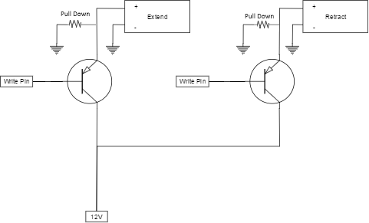
Pneumatic End-effector
BJTs used to control extension
and retraction motion of piston

Slide 4
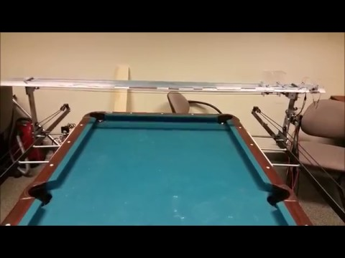
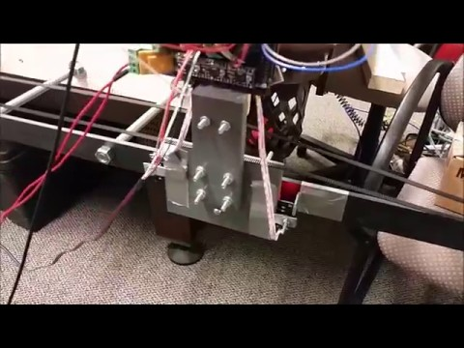
Electrical and Controls Improvements
Speed Up Slow Down
End Stop Anticipation

Slide 5
Electrical and Controls Improvements #2
Simultaneous Motion

Slide 6
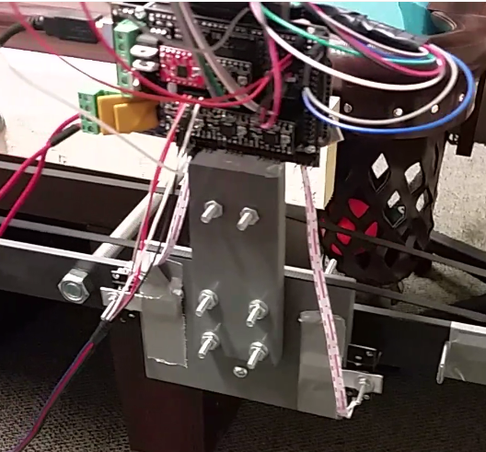
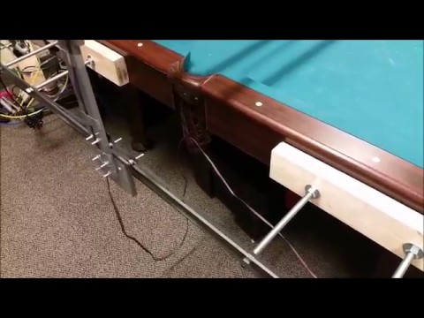
Electrical and Controls Hurdles
Wire management → MCU
Wire management → X rails

